Slide 1


Accenture Innovation Challenge
Harness Generative AI to develop innovative solutions that boost business and societal growth

Slide 2
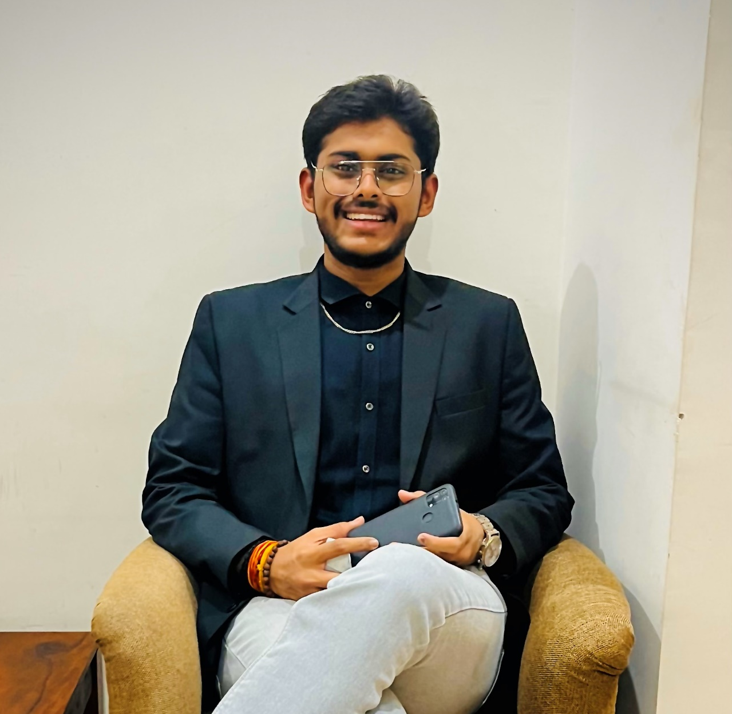
Team details
TEAM NAME: Aero Cluster
Aryan Vishwakarma(Team Leader)
College: Devi Ahilya Vishwavidyalaya (DAVV)
Stream: Integrated B.Tech and M.Tech in IoT (Internet of Things)
Year of graduation: 2027

Slide 3
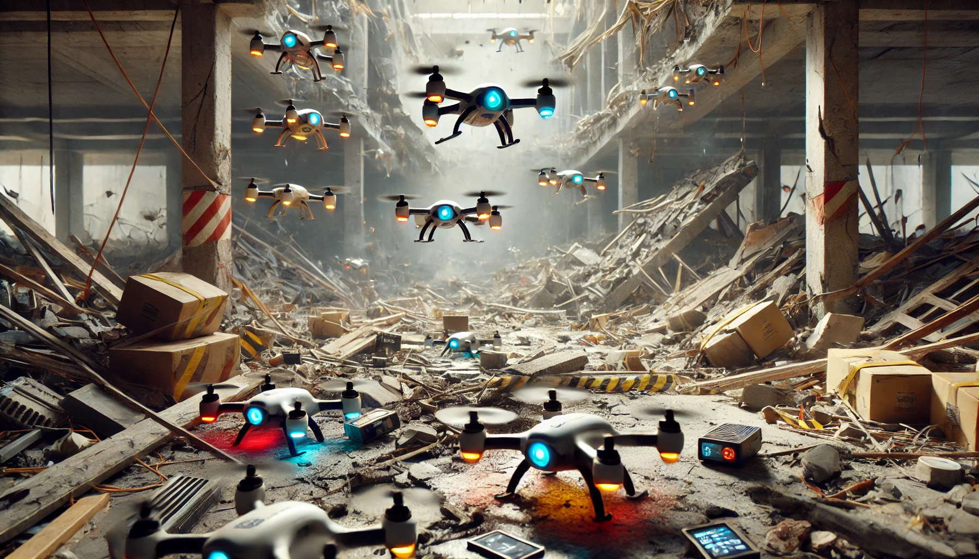
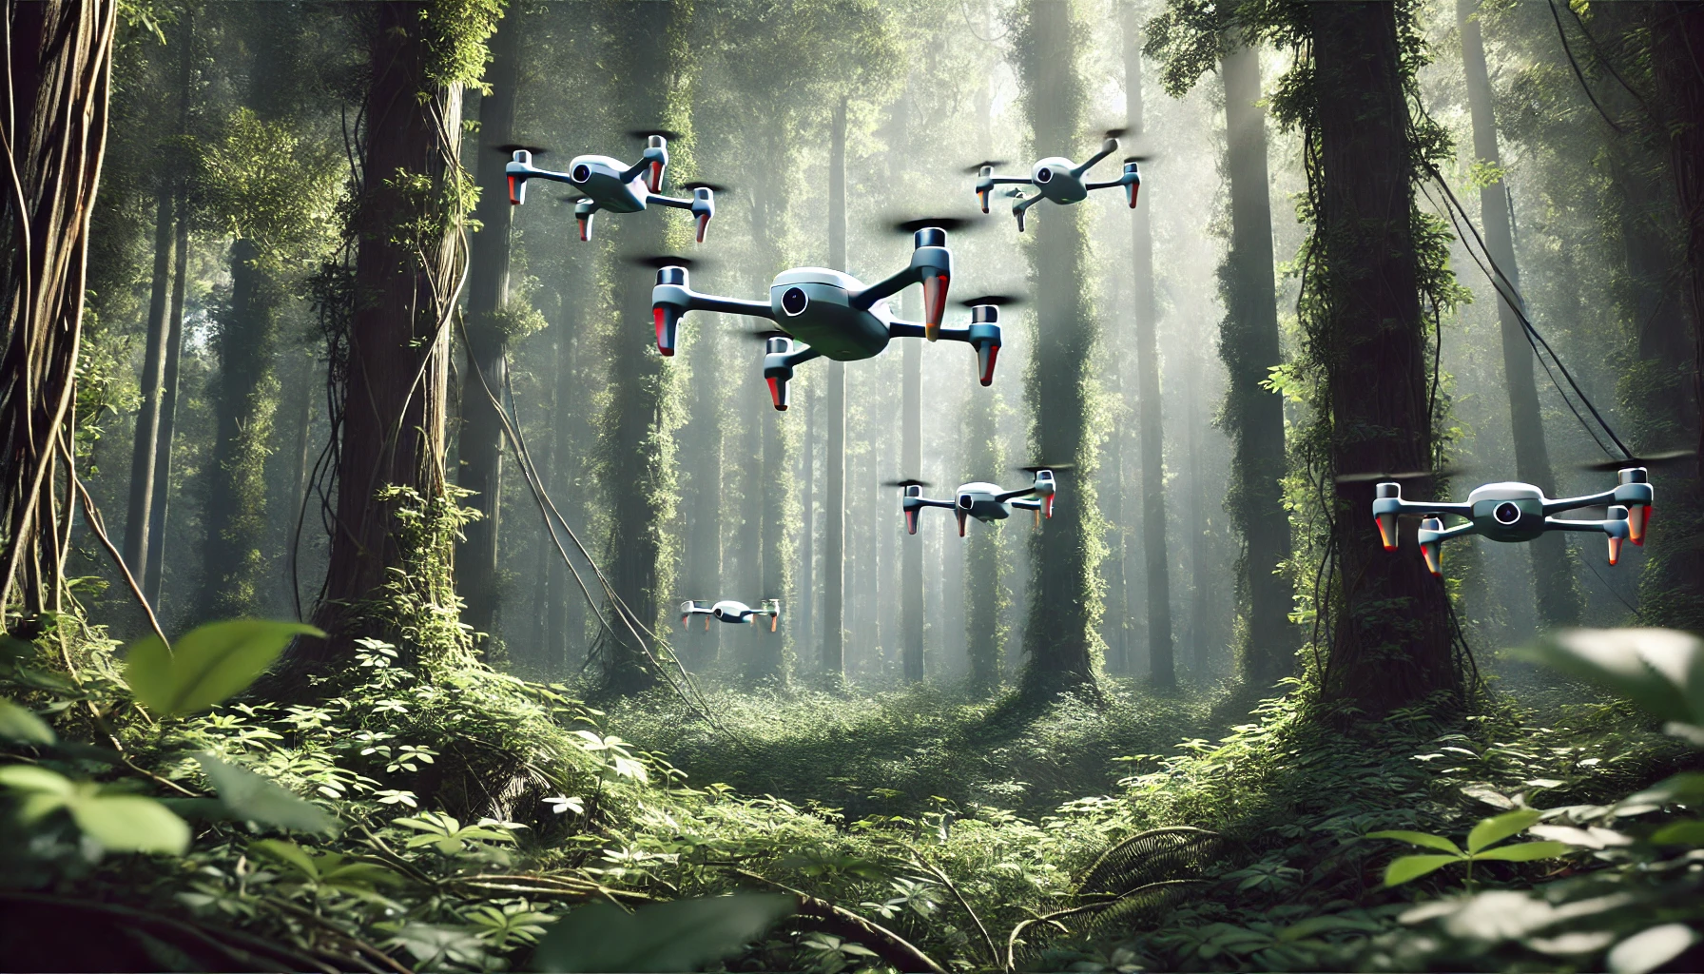
Problem Statement Description (200 words)
The need for agile, efficient, and scalable drone systems has become increasingly important in various fields, particularly in challenging environments where human intervention may be limited or unsafe. "Aero Cluster" aims to develop a swarm of small-sized drones capable of executing coordinated search, attack, and rescue operations. These drones, equipped with Advanced Sensors, Artificial Intelligence (AI), and Machine Learning (ML) algorithms, are designed to maneuver through tight spaces—such as collapsed structures, narrow tunnels, or dense forests—where traditional drones and human responders may struggle.
In search and rescue missions, the drones can identify survivors trapped under rubble and deliver essential supplies. In military and law enforcement contexts, they offer enhanced surveillance, precision in strike operations, and border security by navigating and monitoring high-risk zones with minimal detection. The "Aero Cluster" project also contributes to environmental monitoring and hazardous material detection by autonomously exploring dangerous environments. By leveraging AI and ML, the system improves over time, adapting to complex scenarios while ensuring real-time communication and decision-making among the drone swarm, making it a versatile tool in critical operations.
AI Generated Images To showcase the problem and its solution.

Slide 4
Proposed Solution to the Problem (200 words)
"Aero Cluster" focuses on developing a swarm of compact drones designed for search, rescue, and tactical operations. These drones are equipped to navigate tight and complex environments like dense forests or collapsed buildings, making them highly effective for disaster response and military operations. Each drone is fitted with sensors, AI, and machine learning (ML) algorithms, enabling autonomous decision-making and obstacle avoidance. The drones can map environments, detect survivors, and even deliver essential supplies in dangerous or inaccessible areas. With real-time data transmission, they ensure coordinated responses across the swarm, making them a powerful tool for missions where agility and precision are crucial.
Technology Stack Used
Hardware:
Compact drones with lightweight frames.
LiDAR sensors for mapping.
Thermal and infrared cameras for heat detection.
GPS for location tracking.
Communication modules for inter-drone communication.
Raspberry PI Zero WH for onboard computation and controlling.
Software:
AI Models: For autonomous decision-making and obstacle avoidance.
ML Algorithms: Adaptive learning models for enhanced search operations.
ML Models Used: Support Vector Machine (SVM), Neural Networks.
Navigation Models: Simultaneous Localization and Mapping (SLAM), Obstacle Avoidance Algorithms.

Slide 5

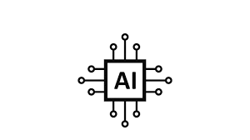
How does your innovation accelerate change with the power of Technology? (200 words)
Our innovation, "Aero Cluster“, accelerates change by leveraging cutting-edge technology to solve critical real-world challenges with speed, efficiency, and precision. Traditional methods of search, rescue, and tactical operations often rely on human intervention, which can be slow, dangerous, and limited by environmental constraints. Aero Cluster transforms these operations with autonomous, AI-powered drones that can swiftly navigate complex and hazardous environments, such as collapsed buildings or dense forests.
The integration of artificial intelligence (AI), machine learning (ML), and advanced sensor systems allows the drones to make real-time decisions, adapting dynamically to changing conditions. For example, in disaster scenarios, these drones can quickly locate survivors, map the terrain, and deliver supplies, vastly reducing the time it takes to conduct rescue missions.
Furthermore, the scalability of drone swarms allows for parallel task execution, ensuring that multiple objectives—like search, surveillance, and data collection—are addressed simultaneously. This not only saves lives but also minimizes risk to human responders. Through Aero Clusters, technology acts as a catalyst for accelerating operational efficiency, enabling a more responsive and adaptable approach to life-saving missions, ultimately driving transformative change in how critical operations are conducted across various industries.
M L

Slide 6
How is your solution different/unique from other solutions in market? (150 words)
Our solution, "Aero Cluster“, stands out from other market offerings by focusing on small-sized, highly maneuverable drones equipped with advanced AI and machine learning (ML) capabilities, specifically designed to operate in tight, hard-to-reach spaces. Unlike traditional drone systems that struggle in confined environments, our drones excel in navigating through collapsed structures, dense forests, and other challenging terrains.
What sets us apart is the combination of real-time adaptive decision-making, autonomous obstacle avoidance, and multi-functional swarming capabilities. While other solutions may focus on either search or surveillance, Aero Clusters seamlessly integrates search, rescue, and tactical operations in a single system. Additionally, the use of advanced ML models like SVM and SLAM enables the drones to improve over time, making them smarter and more efficient with each operation. This versatility, combined with the ability to operate autonomously in complex environments, makes Aero Clusters a unique and powerful solution.
PATENT FILED: No (Current Status)
Do you have a working model/prototype: Yes & No
If not, will you be able to show working prototype during finale: Yes
(If funding is provided, a better prototype can be displayed)

Slide 7

Any testimonials received?
As a 3rd-year student, Aryan Vishwakarma has consistently demonstrated academic excellence and an impressive ability to build innovative projects in the IoT and technology space. I have had the pleasure of working with Aryan Vishwakarma on various projects, where their proficiency in both hardware and software development stood out. Their keen problem-solving skills and commitment to quality have led to remarkable outcomes. I am confident that Aryan Vishwakarma will excel in the project they are building for Accenture, delivering outstanding results with their comprehensive technical knowledge and creativity.
Dr. Mahendra Rathor
Professor and Mentor

Slide 8
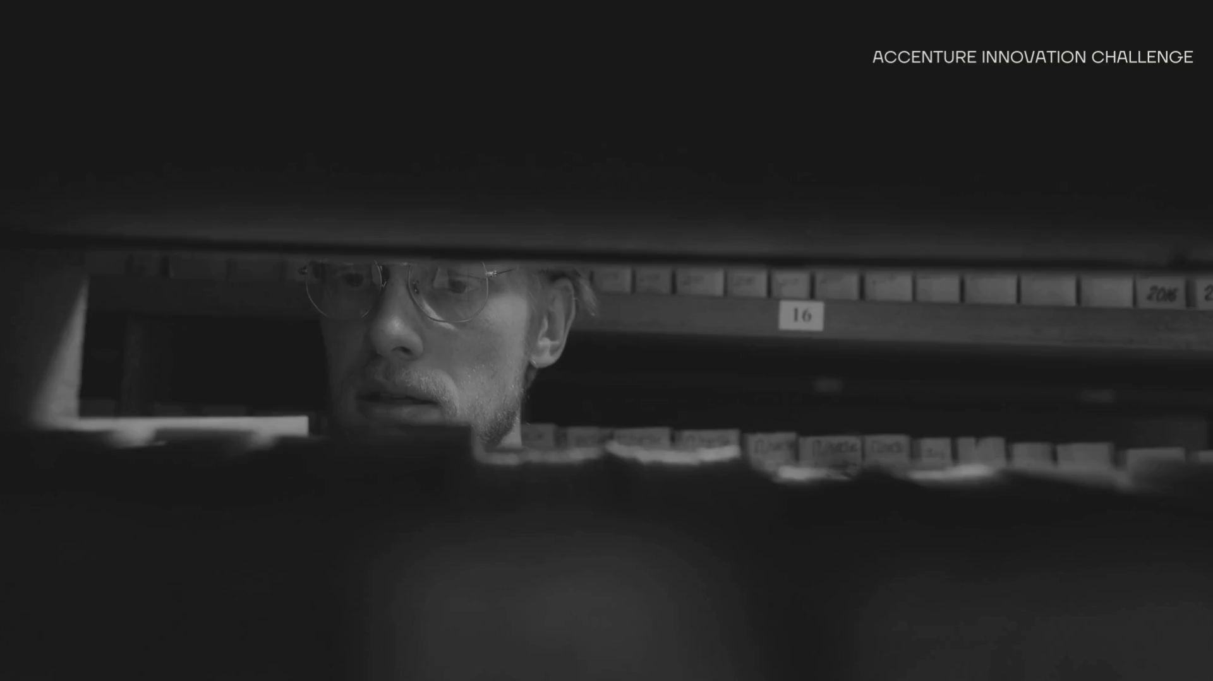
Please share a 1-minute video of your idea (embed on this PPT or add a downloadable link)
Downloadable Link For Video :- https://youtu.be/cI1LoOoJlrc

Slide 9
Thank you!

